Slide 1
Business Models
Prof. Dr. Dirk Riehle
Friedrich-Alexander University Erlangen-Nürnberg
COSS B04
Licensed under CC BY 4.0 International
Notes:
It is Friedrich-Alexander University Erlangen-Nürnberg – FAU, in short.
Corporate identity wants us to say “Friedrich-Alexander University”.

Slide 2
Summary
Business model (definition)
Business model canvas
Value proposition
Value capture
Value creation
Business model types

Slide 3
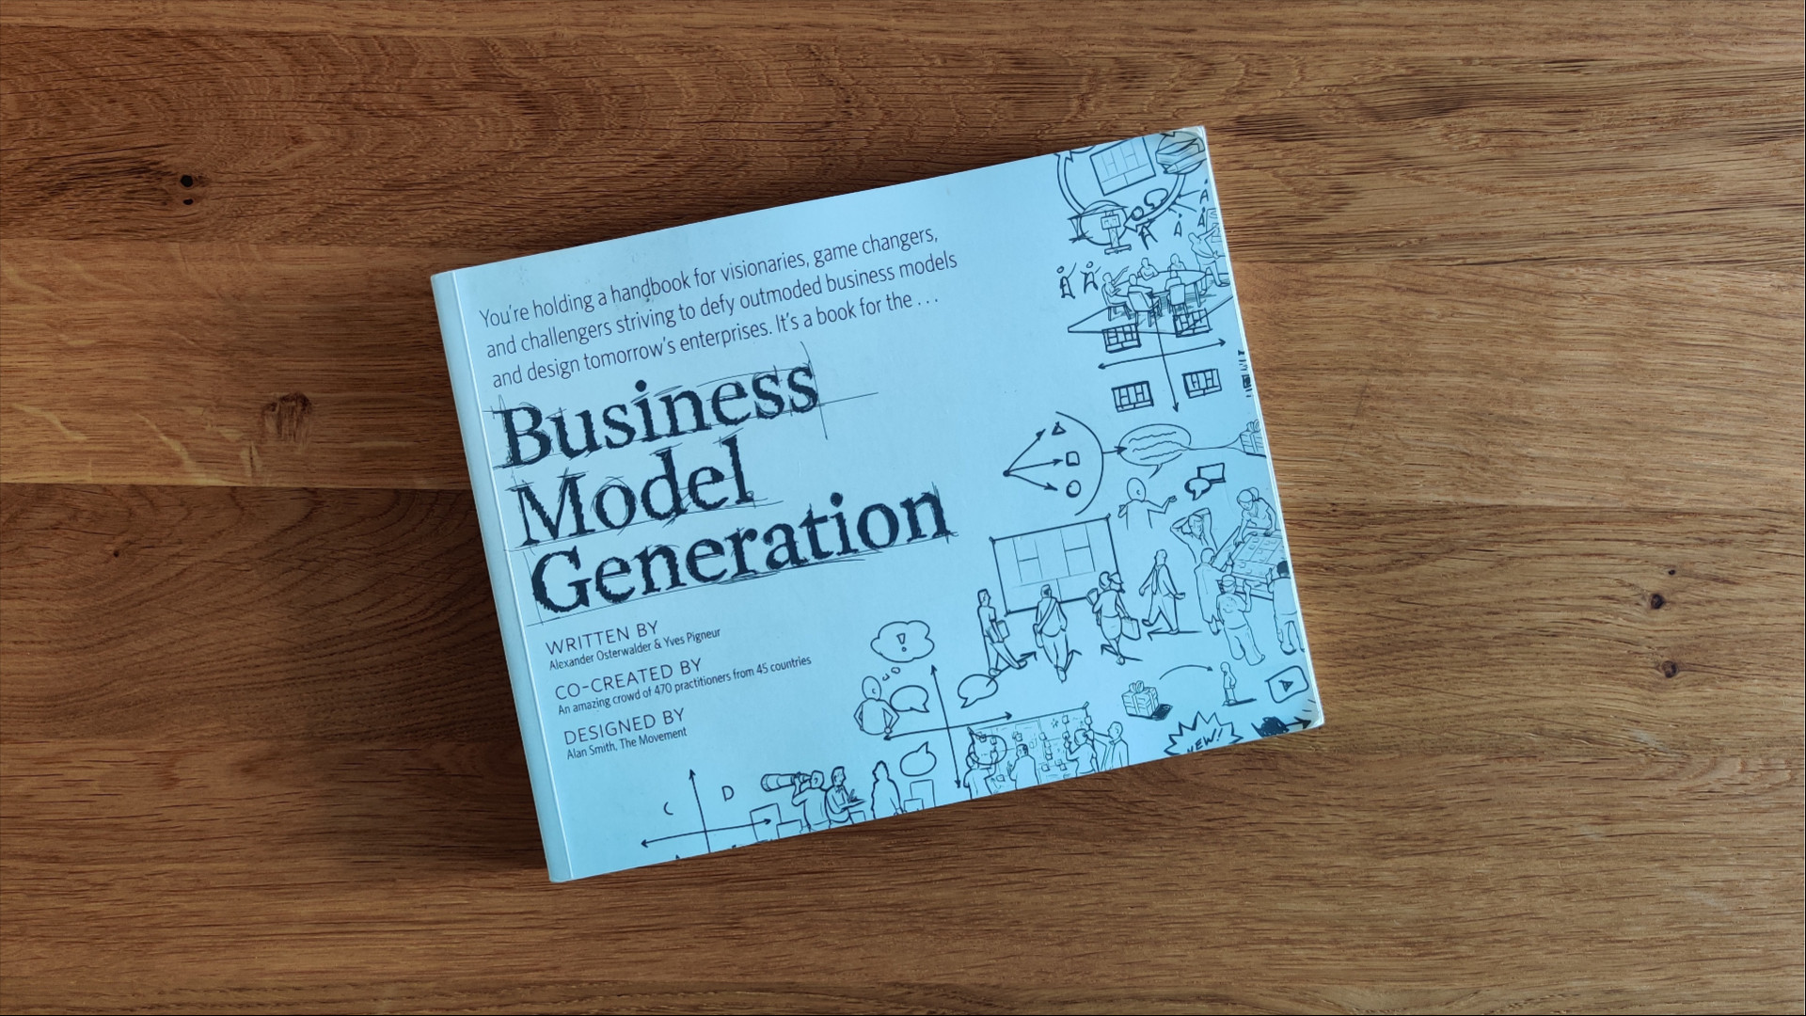

Slide 4
1. What is a Business Model?

Slide 5
Business Model (Definition)
A business model
  A model (description) of how an organization creates, delivers, and captures value
A model
  Is a description of components and how they interact for a purpose
A model gets instantiated a.k.a. executed

Slide 6
2. The Business Model Canvas

Slide 7
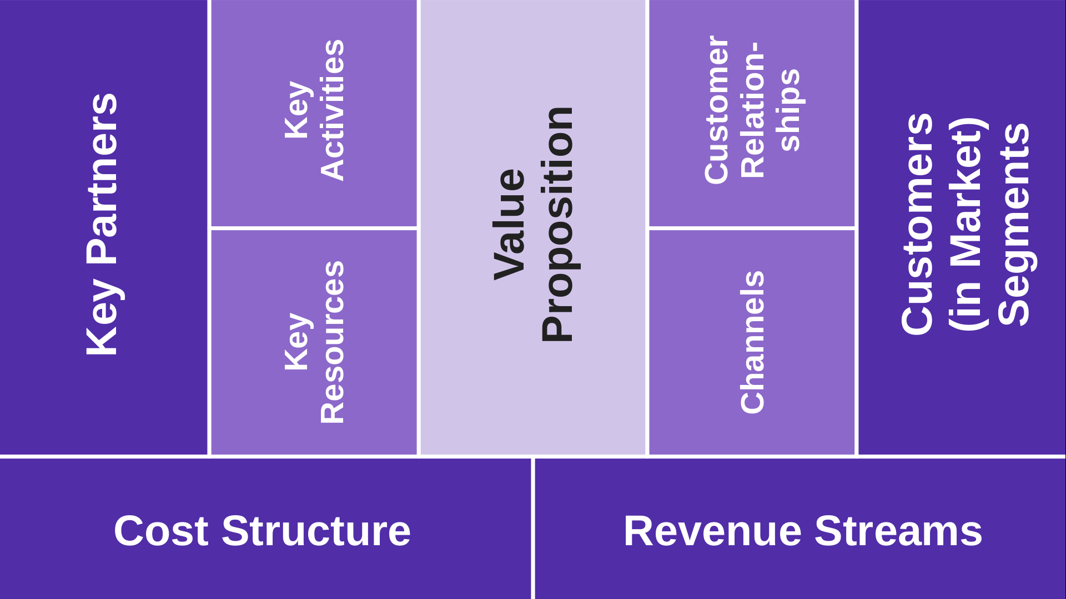
The Business Model Canvas (BMC)
Value creation
Value capture

Slide 8
Components (of a Business Model)
Value proposition
Value capture
  Market segments
  Channels
  Customer relationships
  Revenue streams
Value creation
  Key partners
  Key activities
  Key resources
  Cost structure

Slide 9
3. Value Proposition

Slide 10
1. Value Proposition
The value proposition
  Is the value to customers (so they buy)
    Creating a gain or relieving a pain
    Solving a problem or fulfilling a need
  Turned into a product or service
    Cast as a minimum viable product
    Consisting of distinct features
The value to customers can be predominantly
  Quantitative (speed, price)
  Qualitative (convenience, novelty)

Slide 11
Examples of Creating a Gain or Relieving a Pain
Remove boredom
Relieve pain
Improve well-being
Display status
Need
Problem / Need
Create savings
Eliminate risks
Improve work quality
Open up new market
Problem
Pain
Gain
Pain / Gain

Slide 12
Quantifying the Customer Gain or Pain
By intensity or relevance of incidents
By frequency of incidence

Slide 13
4. Value Capture

Slide 14
Value Capture
Value capture (also: appropriation)
  Is the comprehensive process of
    Deriving a revenue stream
    By selling to customers in a market segment
    A product or service built on a value proposition\
    Through a channel that reaches the segment
    Using customer relationships
  Can vary by market segment
    Creates a unique combination then

Slide 15
2. Customers (in Market) Segments
A market segment
  Is a cohesive cluster of similar customers
In multi-sided markets
  You have multiple types of customers, split further into segments
All market segments together constitute the total market

Slide 16
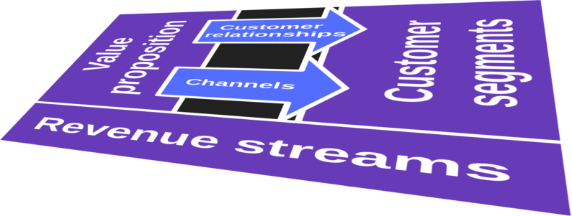
Value Proposition Matches Market Segment
Value proposition varies by segment
  Specific value proposition defines the profile that marks the segment
Market segment profiles can vary significantly
  Various characteristic properties

Slide 17
Personas
user
user’s
manager
A persona
  Is an archetypal [1] person
  Within an archetypal customer
  Within a market segment
At any customer
  There are likely to be several personas
  All with different powers re: purchase
  And different profiles
IT department
economic buyer
[1] Archetypal = representing a cluster of similar people

Slide 18
Example Market Structure Breakdown
Dimension | Example
Markets | Cars; beanie babies; ...
Customer types | Car buyers, car sellers; beanie baby collectors; ...
Market segments | Truck buyers/sellers; minivan buyers/sellers; sports car buyers/sellers; ...
Personas | Truck-buyer-user, truck-buyer-economic-buyer, truck-buyer-maintainer, ...

Slide 19
3. Channels
A channel
  Is a well-defined process (conduit) of reaching a market segment
  Can be physical or digital
Channels are used to sell to customers

Slide 20
Physical vs. Digital
Books
Software
Digital
Channel
Food
Events
Physical
Physical
Digital
Product

Slide 21
Examples of Software Distribution Channels
Digital
  Own web store
  Platform app store
  Digital retailers
Physical
  Book stores
  Electronic stores
  System integrators

Slide 22
Direct vs. Indirect Channel Sales
In a direct channel sale
  Your company sells directly to the customer
  You make maximum profit
In an indirect channel sale
  Your company sells through a reseller
  Your profit drops by the cut intermediaries are taking
  Some of your SG&A costs drop because selling got simpler

Slide 23
4. Customer Relationships
As a business, you need to understand how to
  Get
  Keep, and
  Grow your customer base
For this, you use personas (see market segment discussion)
(customer)
personas

Slide 24
Customer Acquisition (Getting Customers)
Marketing primes the sales funnel
  Tries to create demand
    Advertising
    Trade shows
    Trade magazines
    Email, webinars
  Output: Qualified leads
Sales takes over qualified leads
  Consumer
    Low-touch sales
    Web store
  Enterprise
    High-touch sales
    Evaluation
    Sale
  Output: Sale + customer
Awareness
Discovery
→ qualified lead
Evaluation
Intent
Buy
→ customer

Slide 25
Customer Acquisition Cost (CAC)
Each step in the sales funnel
  Has a cost associated with every potential customer entering it
  Reduces the number of potential customers moving forward
Customer acquisition cost
  Is the accumulated cost normalized for one realized customer
  Is a key metric (cost) to be matched against revenue

Slide 26
Example CAC for Enterprise Software Product
 | Cost per lead | Survival rate | No customers | Total stage cost
Trade show lead | 100 € | 100 % | 10 | 1.000 €
Evaluation | 5.000 € | 20 % | 2 | 10.000 €
Sale | 2.000 € | 50 % | 1 | 2.000 €
Customer acquisition cost = |  |  |  | 13.000 €

Slide 27
Customer Retention (Keeping Customers)
Retaining existing customers is 5-10 times cheaper than acquiring new ones
Techniques for retaining customers
  Foremost, keep delivering a great product
  Then create loyalty program, added benefits
  Increase switching costs to lock-in customers

Slide 28
Customer Attrition (Churn)
Customer churn
  Is the percentage of customers you loose in a given time period
Customer lifetime = 1 / churn
  For example, a 1% churn rate = 100 months of customer lifetime
Churn | Period
 | Start | 1 month | 6 month | 1 year | 2 years | 5 years
20 % | 100 | 80 | 26 | 7 | 0 | 0
10 % | 100 | 90 | 53 | 28 | 8 | 0
5 % | 100 | 95 | 74 | 54 | 29 | 5
1 % | 100 | 99 | 94 | 89 | 79 | 55

Slide 29
Customer Growth
Growing your customer base is cheaper than acquiring new customers
Techniques for growing your customer base
  Up-sell your customers
  Cross-sell them
  Get referrals

Slide 30
Customer Lifetime Value (CLV)
The lifetime value of a customer is
  The total profits from the customer over time in today’s currency
Steps to calculate (the average) CLV
  Determine customer lifetime (from customer churn)
  Determine customer margin from revenues and variable costs
  Discount period profits by how far out the revenues are
Customer costs include
  Relationship costs (acquisition, retention, growth)
  Variable product or service provision costs

Slide 31
Heuristics for the Customer Lifetime Value
CLV should be >> than CAC
  CAC dominates most costs
Rules of thumb vary by domain

Slide 32
5. Revenue Streams
Revenue (income)
  A payment received from a customer
A revenue source
  Is a synonym for customer
A revenue stream
  Is the stream of revenues received from a source over time
An aggregate revenue stream
  Is the aggregation of several revenue streams from different sources
The total revenue stream
  Is the aggregation of all revenue streams
Business intelligence lets you analyze your revenue streams

Slide 33
Pricing
The price of a unit of product or service
  Is the money charged to the customer for that unit of product or service
  Is best set equal to the value the potential customer sees in it
  The value of a unit of product or service varies by time
  This maximizes revenues by customer
Price discrimination
  Is the process of setting prices specific to a customer
  Then, you can try to capture maximum value
If you can’t price discriminate, you price
  By segment
  By channel
Always price based on value, never on costs

Slide 34
How Revenue Streams are Structured
Individual sale (revenue)
  Is price x no units of product or service sold
Revenues can be aggregated resp. broken down in many ways
  By market structure: Markets → market segments → customers
  By classic (physical) break-down: location, demographics
  By channel: Web store, retailer, etc.
Prices (incl. volume discounts) may vary by breakdown

Slide 35
5. Value Creation

Slide 36
Value Creation
Value creation
  Is the comprehensive process of
    Creating your product or service for customers and evolving it
  Also: production and operations

Slide 37
6. Key Partners
A key partner is another organization you strike a deal with
  To operate your own organization or
  To produce your product or service

Slide 38
Types of Partnerships
Suppliers
  To build your product from components
  Example: Apple + Foxconn
Strategic alliances
  To build a whole product
  Example: SAP and its consulting partners
Joint business development
  To jointly promote complementary products
  Example: Intel (Inside) and computer manufacturers
Strategic investors
  To raise funds and gain access to important resources
  Example: Daimler investment in Tesla

Slide 39
Success Factors and Failure Reasons of Partnerships
Success factors
  Understand your core value proposition
  Focus on your competitive differentiation
Failure reasons
  Not understanding each other’s motivation
  Not seeing eye to eye (small vs. large co.)

Slide 40
7. Key Resources
A key resource
  Is an asset (resource) needed to operate your business
  Is therefore a key competitive differentiator
Resource categories (types)
  Materials
    Tangible (raw materials, production facility)
    Intellectual property
  Capital
  Labor

Slide 41
Tangible Materials (Resources 1 / 4)
Types of tangible resources
  Raw materials
    Input to production
  Production facilities, e.g. machinery
    Used to produce
Sources of tangible resources
  Owned or paid for

Slide 42
Intellectual Property (Resources 2 / 4)
Types of intellectual property
  Copyright
  Patents
  Trademarks
  Trade secrets
  Contracts
Sources of intellectual property
  Own invention
  Built-up over time
  University and research institutions
  Purchased from elsewhere
  Strategic partnership with elsewhere

Slide 43
Capital (Resources 3 / 4)
Types of capital
  Financial resources
  Operating capital
Sources of capital
  Friends and family
  Bank loans
  Venture capital
  Leasing, factoring

Slide 44
Labor (Resources 4 / 4)
Relevant aspects
  Quality of labor (how skilled a workforce?)
  Quantity of labor (how many?)
Sources of labor
  Local labor market
    Local universities
  Globally sourced remote work

Slide 45
8. Key Activities
A key activity
  Is a core business process needed to operate the business
  Therefore is critical to create, deliver, and maintain value proposition
  Is a key competitive differentiator
  Should not be outsourced
Example key activities
  Software development
  Cloud operations

Slide 46
9. Cost Structure
The cost structure of a business
  Is a model of the costs (expenses) needed to operate and scale your business
Cost categories
  Fixed costs
  Variable costs
Traditionally, the cost structure is expressed in the income statement

Slide 47
Fixed vs. Variable Costs / Economies of Scale
100%
variable cost %
total cost per unit
# units
(scale)

Slide 48
Fixed / Variable Costs in Software / Software-as-a-Service
Software / fixed costs
  Software development
    Initial software development
    Continued development
Software-as-a-Service / fixed costs
  Software development
    Initial software development
    Continued development
  Operations
    Cloud infrastructure (fixed costs)
    Site reliability engineering
Software / variable costs
  Customer support services
Software-as-a-Service / variable costs
  Customer support services
  Operations
    Compute power per customer

Slide 49
6. Business Model Types

Slide 50
Types of Business (Models) [HS99]
 | Product Innovation | Customer Relationship Management | Infrastructure Management
Economics | Early market entry allows for a premium price and large market share; speed is key | High cost of customer acquisition makes it imperative to gain large shares of wallet; economies of scope are key | High fixed costs make large volumes essential to achieving low unit costs; economies of scale are key
Culture | Employee centered; codding the creative “stars” | Highly service-oriented, “customer-first” | Cost focused; stress on standardization, predictability, efficiency
Competition | Battle for talent; low barriers to entry; many small players thrive | Battle for scope; rapid consolidation; a few big players dominate | Battle for scope; rapid consolidation; a few big players dominate

Slide 51
Summary
Business model (definition)
Business model canvas
Value proposition
Value creation
Value capture
Business model types

Slide 52
Thank you! Questions?
dirk.riehle@fau.de – http://osr.cs.fau.de
dirk@riehle.org – http://dirkriehle.com – @dirkriehle
DR

Slide 53
Credits and License
Original version
  © 2020 Dirk Riehle, some rights reserved
  Licensed under Creative Commons Attribution 4.0 International License
Contributions
  None yet

